Slide 1
Hand-Rolled Manufacturing
SKT Information System: Scope of Work
Surabaya, 17 March 2015
Status: Draft

Slide 2
Agenda
Introduction
Project Scope
Project Timeframe
SKT Business Process
SKT IS Business Requirements
  SKT Plant Production Planning
  SKT Plant Production Execution
  SKT Plant Wages System
  SKT TPO Production Planning
  SKT TPO Production Execution
  SKT TPO Fee
  SKT Production Equipment & Maintenance
  SKT Application Security
  SKT Reports

Slide 3
Introduction
Background
The main user of this solution is the Hand-rolled cigarette manufacturing that reports to manufacturing Management.
Hand-rolled cigarette Production has 6 main functions in overall as follow:
  SKT Plant Production Planning
  SKT Plant Production Execution
  SKT Plant Wages
  SKT TPO Production Planning
  SKT TPO Production Execution
  SKT TPO Fee
Hand-rolled cigarette Support has 2 main functions in overall as follow:
  Product Equipment & Maintenance
  Product & Stock
SKT Information System (SKT-IS) is the application to ease the Hand-rolled manufacturing in managing an effective production process and seeking continuous improvement in productive administration activities. Currently SKT-IS is an exist application and will reengineering with same business process using VB.NET interface and SQL Server databases.

Slide 4
Introduction
Project Objective
To provide effective and reliable system solution that meet business expectations of the new SKT-IS:
  Having the functionality and feature that meet the current hand rolled manufacturing process.
  Make SKTIS application more efficient and simple than existing SKTIS Applications.

Slide 5
Agenda
Introduction
Project Scope
Project Timeframe
SKT IS Business Process & Requirements
  SKT Plant Production Planning
  SKT Plant Production Execution
  SKT Plant Wages System
  SKT TPO Production Planning
  SKT TPO Production Execution
  SKT TPO Fee
  SKT Production Equipment & Maintenance
  Application Access Rights
  Masters
  Reports

Slide 6
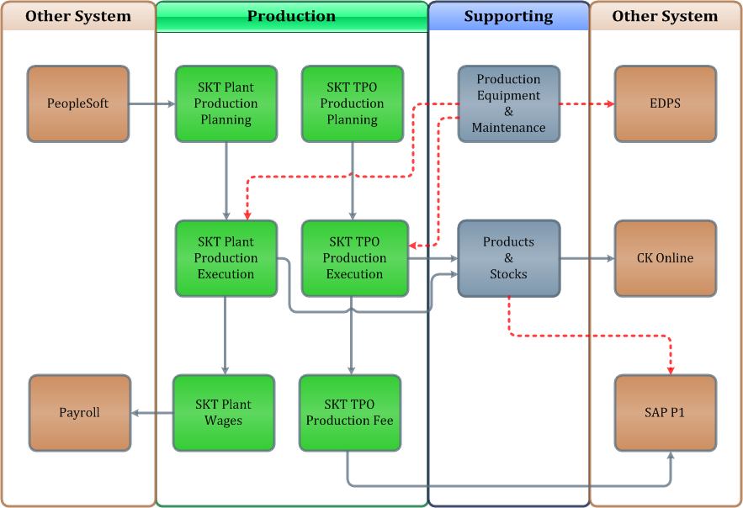
Project Scope
Processes
The new SKT-IS is expected to cover the overall hand rolled cigarette manufacture process in the organization. This is defined in new technology:

Slide 7
Project Scope
Interface:
The existing SKT-IS application interface is using Excel VB Application and Classic ASP,
will be reengineering to be Web application using VB.NET.
Database:
The existing SKT-IS application database is using ORACLE,
will be reengineering to SQL Server Database, and SQL Server Integration Services for data interfacing, data processing, and process scheduling.
The data have including replication technology to user local PC to speedup transaction activity, using possible solution (e.g. CITRIX, XML)

Slide 8
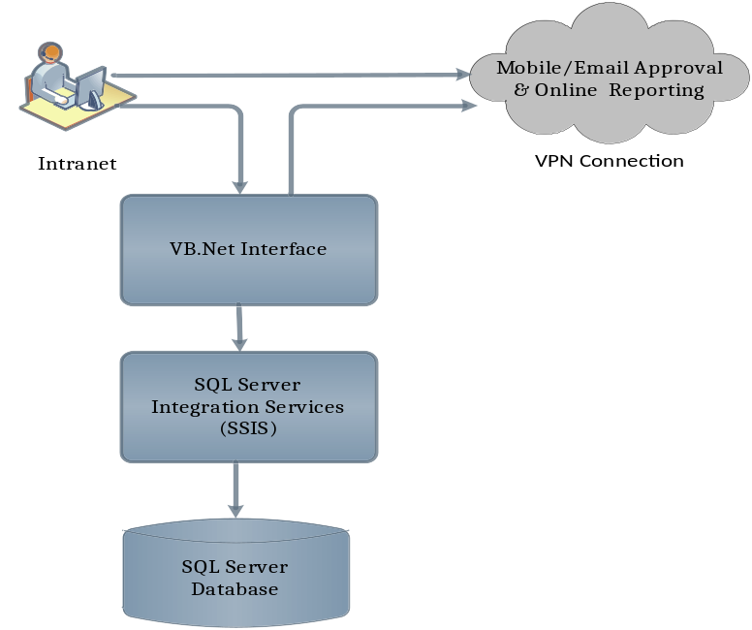
Project Scope
Interface: The existing SKT-IS application interface is using Excel VB Application and Classic ASP,
will be reengineering to be Web application using VB.NET.
Standards: .NET Framework 4.5, IIS 7.5 upgradeable to IIS 8.5, HTML5, IE 11
Database: The existing SKT-IS application database is using ORACLE, will be reengineering to SQL Server Database, and SQL Server Integration Services for data interfacing, data processing, and process scheduling.
The data have including replication technology to user local PC to speedup transaction activity, using possible solution (e.g. CITRIX, XML)
Standards: SQL Server 2008 Integration Services SP 2 upgradable to SQL Server 2012 Integration Services SP 1

Slide 9
Project Scope
Other System Integration
People Soft: Source data for piece rate worker in SKT Plant
Payroll: To calculate payment of the SKT Wages System
EDPS (Electronic Disposal Process System): To dispose bad stock of production equipment
SAP P1 (PMI Standard ERP system): To record the calculation of TPO Fee, and to record the summarize the product outputs of tax stamping process (Finished Goods)
CK Online: To record the product outputs of Finished Goods and Non Finished Goods Cigarette Sticks, and also the intermediate cigarette sticks stocks

Slide 10



Project Scope
Legal Entities/ Geography
As the existing system, SKT Information System will be implemented for Hand-rolled cigarette manufacturing user at Main Office Surabaya, 5 SKT Plants which are all in East Java, and 38 SKT TPOs which are all in Java.
Region 3
Region 1
8 TPO Plants
10 TPO Plants
Surabaya SKT Plants
Rungkut I
Rungkut II
Taman Sampoerna
Java Island
Region 4
Region 2
10 TPO Plants
10 TPO Plants
Malang SKT Plant
Kraksaan SKT Plant

Slide 11
Agenda
Introduction
Project Scope
Project Timeframe
SKT Business Process
SKT Business Requirements
  SKT Plant Production Planning
  SKT Plant Production Execution
  SKT Plant Wages System
  SKT TPO Production Planning
  SKT TPO Production Execution
  SKT TPO Production Fee
  SKT Production Equipment & Maintenance
  Application Access Rights
  Masters
  Reports

Slide 12
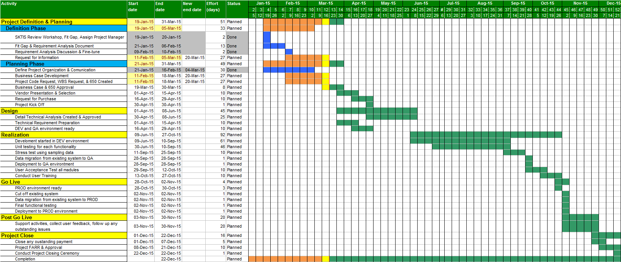
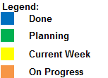
Project Timeframe
SKT Information System is expected to reach go-live stage in November 2015.

Slide 13
Agenda
Introduction
Project Scope
Project Timeframe
SKT Business Process
SKT IS Business Requirements (based on Existing System)
  SKT Plant Production Planning
  SKT Plant Production Execution
  SKT Plant Wages System
  SKT TPO Production Planning
  SKT TPO Production Execution
  SKT TPO Fee
  SKT Production Equipment & Maintenance
  Application Access Rights
  Masters
  Reports

Slide 14
SKT Business Process
Machine Made
Maker
Packer
Case
Packer
Hand-Rolled
Rolling
Cutting
Packing
Tax Stamp
&
Slof (carton)
Bale
&
Case
Intermediate Product
Cut Sticks
Intermediate Product
Packs without Stamp
Finished Product
Shipping Case
Intermediate Product is to maintain process continuity, next process can start at the same time without delay. The buffer stock is equivalent to the supply for next process in 1 hours of production

Slide 15

SKT Business Process
Rolling
Cutting
Packing
Tax Stamp
&
Slof (carton)
Bale
&
Case
 | 325 | 1000 | 1620 | 7200
 | 410 | 1525 | 1512 |  | New Device
 | 325 | 1000 | 1141 | 2080
 | 325 | 1000 | 1620 | 7200
 | 325 | 1000 | 2054 | 7580
 | 325 | 1000 | 1008 | 1767
 | 325 | 971 | 1008 | 1767
 | 325 | 1000 | 1426 | 6008
process main streams: production and inventory

Slide 16
Agenda
Introduction
Project Scope
Project Timeframe
SKT Business Process
SKT IS Business Requirements (based on Existing System)
  SKT Plant Production Planning
  SKT Plant Production Execution
  SKT Plant Wages System
  SKT TPO Production Planning
  SKT TPO Production Execution
  SKT TPO Fee
  SKT Production Equipment & Maintenance
  Application Access Rights
  Masters
  Reports

Slide 17
SKT Plant Production Planning
The module of SKTIS to cascade Weekly Production Planning of each plant down to detail daily production target of each worker.
Prod. Capacity
in Specified
Work Hours
PeopleSoft
Worker
Brand Assignment
Group Shift Assignment
Individual Capacity
Weekly Production Planning
Production
Unit Target
Production Group Target
Production Entry per Worker Created
Print Manual Entry
Balancing Process
SKT Plant
Production Execution
Worker Allocation
Target Adjustment
Process Work Hour
Worker Allocation
Target Adjustment
Daily Work Hours
Attendance
Productivity
Historical Production Data

Slide 18
SKT Plant Production Execution
The module of SKTIS to record all information of worker attendance, working assignment, production target, and actual production
Maximum
Past 2 Weeks
SKT Plant
Production Planning
Production Revision Request Approval
Individual Capacity
Entry Actual Work Hours per Process
Production Revision
PeopleSoft
Record the Absent worker
Working Assignment
Production Entry per Worker
SKT Plant
Production Plant Wages
Duration
Employee Job Data Change
Checking every 3 hours
Absent Worker
Production Target
Actual Production

Slide 19
SKT Plant Wages
The module of SKTIS to integrates production execution module with payroll system
PeopleSoft
Actual Production per Worker
Absent
Payroll Code
Replace Unpaid Absent with Paid Leave
SKT Plant
Production Execution
Actual Production Verification
Production Card Daily
Production Card Approval
Payroll
Add/Adjust Other Incentive if any

Slide 20
SKT TPO Production Planning
The module of SKTIS to cascade weekly production target of a plant down to detail daily production target of production group at TPO.
SKT Capacity Portfolio
Weekly Production Planning
Production Group Target
Production Group Entry Created
SKT TPO
Production Execution
Worker Allocation
Weighted Adjustment
Daily Work Hour
Attendance
Productivity
Capacity Utilization
Historical Production Data
*) 1 Package: The capacity of producing 234 million sticks of cigarette by 360 rolling worker on normal 40 working hours in 50 weeks / 1 year
360 x 325 x 40 x 50 = 234,000,000

Slide 21
SKT TPO Production Execution
The module of SKTIS to record all information of worker attendance, multi-skilled, and actual production at TPO
SKT TPO
Production Planning
Entry Attendance per Group
Entry Multi-skilled Worker per Group
Entry Actual Production per Group
SKT TPO
Production Fee
Entry Actual Work Hours per Process

Slide 22
SKT TPO Production Fee
The module of SKTIS to calculate TPO production fee, approval process, and create flat file to upload into SAP P1 Account Payable.
SKT TPO
Production Execution
Production Data Verification
Finished Product
TPO Production Calculation
TPO Fee Calculation
TPO Fee Approval
SAP P1
Account Payable

Slide 23
Production Equipment & Maintenance
The module of SKTIS to record all transaction of production equipment and spare parts inventory, and maintenance activities
Equipment
On QI
Equipment
On Used
Equipment Request
Request Approval
Procurement Process
Equipment Received from Suppler
QI Process
Transfer to Production Floor
Transfer to Other Location
Equipment Ready to Used
Equipment
On Repair
Repair Process
Disposal
Process
Stock Adjustment/
Change Status
Spare-part
Usage
Item
Conversion
Equipment
Bad Stock
e-DPS

Slide 24
Products & Stocks
The module of SKTIS summary and reports as source data for other related system
Production Report per Status
Finished Goods
SAP P1
SKT TPO
Production Execution
Production Report per Groups
Production Report per Process
Cut Cigarettes Production and Stocks
CK Online

Slide 25
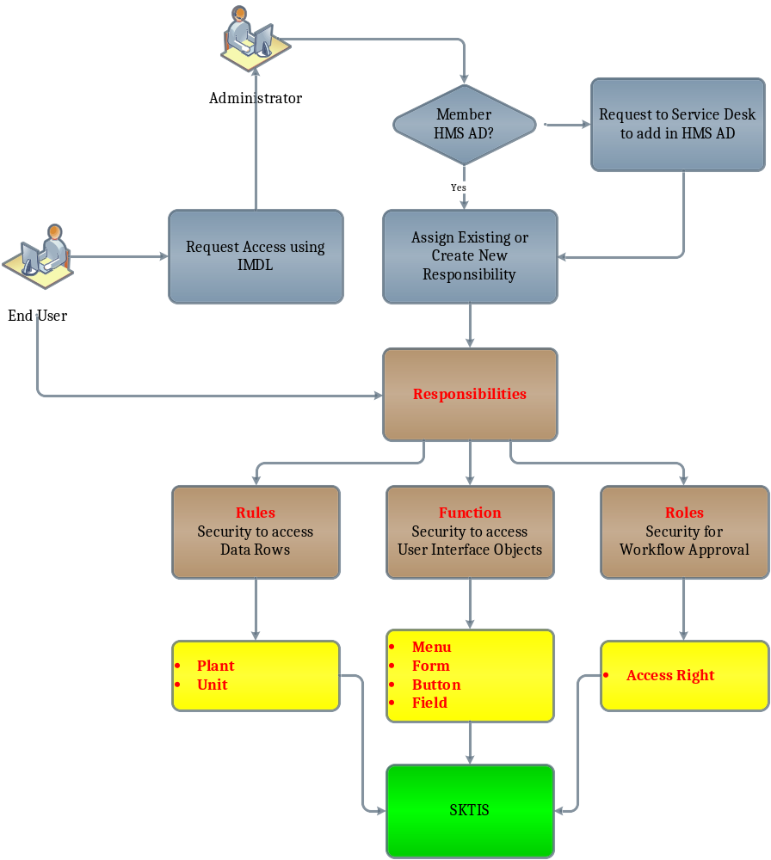
Application Access Right

Slide 26
Masters
Master Group | Master Name
Location | Master Locations
 | Master Units
Brand | Master Brand Groups
 | Master Brand
Process | Master Process Groups
 | Master Production Groups
 | Master Standard Capacity
 | Master Holiday
Labor | Employee Job Data
 | Master Absent Type
TPO | TPO Packages
 | TPO Fee Rates
 | Brand Conversion Mapping
 | Master Work Hours Leveling
 | Product Conversion Mapping
Maintenance | Master Item

Slide 27
Reports
Report Group | Report Name
Planning Monitoring | Summary Production Unit Target
 | Summary Production Group Target
Production Monitoring | Production Report by Group
 | Production Report by Status
 | Production and Stock Report by Process
 | Summary Production by Process
 | Productivity Detail
 | Daily Production Achievement
Wages | Summary Production Card
Labor Monitoring | Absents Report
 | Available Position Number
TPO Fee | Summary TPO Fee
 | View GL (for Month End Closing)
 | TPO Fee, Package, and Production Volume Progress Report
 | TPO Package Report
Maintenance | Equipment Stock
 | Repair Transaction
 | Equipment Movement
 | Equipment Disposal

Slide 28
Thank You
End of slide.

